Slide 1
Population-specific causal effects and modelling pleiotropy
Yoonsu Cho, George Davey Smith, Gibran Hemani
2021-03-24
Work in progress

Slide 2
Motivation
Most MR focuses on Europeans – relevance to global populations?
Is there extra information that we gain by including multiple populations?

Slide 3
Sources of genetic differences between ancestral groups
Biological differences (GxG)
Environmental differences (GxE)
Allele frequency differences (effect is the same but variant is absent)
LD differences (effect is the same but comparing the wrong variant)
If we used e.g. an Asian GWAS for exposure and European GWAS for outcome in MR, all of the above could introduce bias

Slide 4
Idea
Introduce pleiotropy
Model the exposure-outcome effect in multiple ancestries jointly

Slide 5
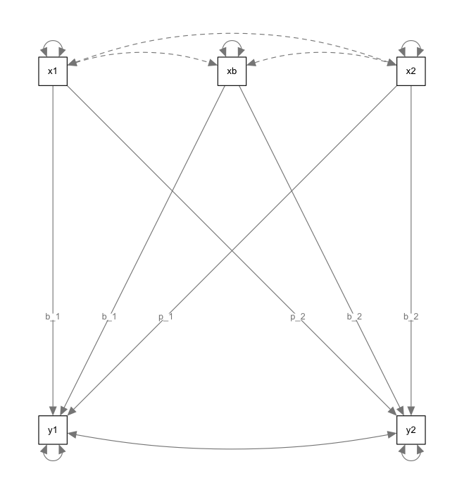
Model for summary data
x1 = SNP-exposure for pop 1
x2 = SNP-exposure for pop 2
xb = shared SNP-exposure
y1 = SNP-outcome for pop 1
y2 = SNP-outcome for pop 2
p_1 = pleiotropic effect pop 1
p_2 = pleiotropic effect pop 2
b_1 = b_iv1 + p_1
b_2 = b_iv2 + p_2

Slide 6
Interpretation
B_1 == B_2
Assume pleiotropy of x1, xb and x2 the same
B_1 != B_2
Can’t assume that pleiotropy at x1 and xb are the same
Evidence for different causal relationships (either different pleiotropy or different causal effects)

Slide 7
Sources of genetic differences
Biological differences (GxG)
B_iv1 vs B_iv2
Environmental differences (GxE)
X_1 vs X_2
Allele frequency differences (effect is the same but variant is absent)
Excluded
LD differences (effect is the same but comparing the wrong variant)
Fine mapping

Slide 8
Other issues
Winner’s curse
Per-population replication samples?
Stricter threshold?
Weak instrument bias
Simulations…
Weighting the SNPs
Use an unweighted model or
Reformulate in the Radial MR framework

